Slide 1

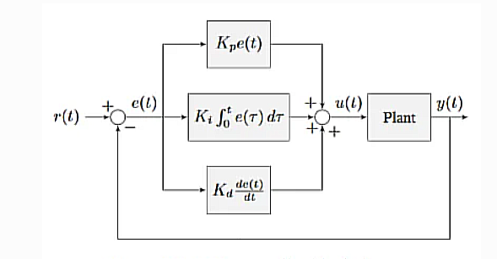
Position PID
Proportional, Integral, and Derivative

Slide 2
The Controller
WPILib PID control all starts with the PIDController. While it differs between libraries, this is how it works in REVLib:

Slide 3
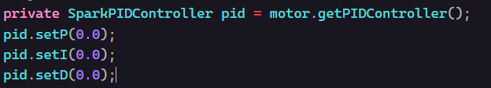

The Gains
After creating our PIDController, we need to set its P, I, and D gains (sound familiar?)
For now, we’ll set them to zero, and discuss what they are in later sections

Slide 4
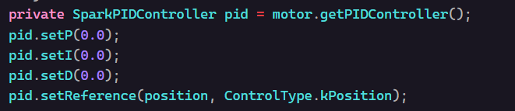

Setting the target 🎯
The next step is to make the motor run to the position. This will be a little easier than last time though…
In one line of code, we set the target position (called a "reference") to our desired position value and told the motor to go to that position!!! (don’t test yet).

Slide 5

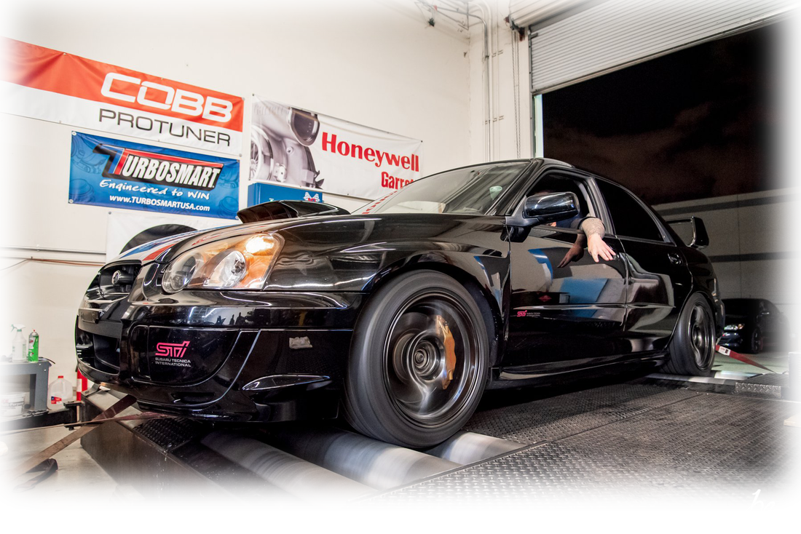
The hard part: tuning
Tuning a PID controller (finding the right P, I, and D values) is the hardest part of position PID. There are 3 steps to the process:
Step 1: Start PID at P=0.2, I = 0.0, D = 0.0
Step 2: Double P until the mechanism starts oscillating
Step 3: Set D equal to 10x P
Step 4: Double D until the mechanism stops oscillating

Slide 6
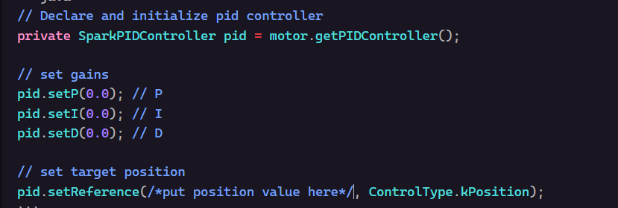

Putting it all together
Below is a full positional PID implementation:
Notes:
Need to decide where to test this PID controller – gearbox w/ some sort of weighted arm??
For "template" purposes maybe just add PID controller to the gearbox+ code

